Slide 1
Regional Bio-Hubs
An Opportunity for Northern Inland NSW
University of New England Armidale – 13 Feb 2014
Colin Barker – NSW Deputy Chair Australian Industrial Ecology Network

Slide 2
Sustainability Advantage Case Studies
9 individual initiatives involving 26 companies were studied with identical methodology to UK data
Lead companies for initiatives were:
  Weston Aluminium James Hardie
  Weston Matrix Boral Cement
  Austral Bricks Worth Recycling
  Polystrom Plastics Owens Illinois
  Dunlop Flooring

Slide 3

Overview of Achievements
Metrics | Units | Outcomes | Attribution
Diversion from landfill | Tonnes | 679,803 | 82%
Virgin material saved | Tonnes | 679,803 | 82%
Energy use saved | Kwh | 1,820,000 | 67%
Reduction in Potable Water | Kl | 40,000 | 100%
Capital Investment | Dollars | 29,800,000 | 44%
Cost Savings | Dollars | 23,102,987 | 66%
Additional Sales | Dollars | 1,000,000 | 100%
Jobs Created | Number of jobs | 79 | 82%

Slide 4
NSW Opportunities
Material | Annual Arising (T) | Unit Value $/T | Nett Position $
Coal washery fines ® | 2,000,000 | 30 | 260,000,000
Flyash ® | 6,000,000 | 30 | 780,000,000
Steel slag fines ® | 125,000 | 30 | 16,250,000
Timber ® | 300,000 | 40 | 42,000,000
Glass ® | 100,000 | 30 | 13,000,000
Tyres ® | 60,000 | 30 | 7,800,000
Plastic ® | 100,000 | 250 | 350,000,000
Fibre cement ® | 30,000 | 30 | 3,900,000
Foundry sand ® | 15,000 | 30 | 1,950,000
Aluminium smelter waste ® | 15,000 | 30 | 1,950,000
Steel ladle refractory ® | 400 | 20 | 48,000
Iron casthouse waste ® | 400 | 20 | 48,000
Carpet off-cuts | 5,000 | 50 | 750,000
Coke oven gas residue ® | 400 | 30 | 52,000
Biomass from livestock ® | 7,000,000 | 30 | 210,000,000

Slide 5
Resource Savings and SA Program
Return on Investment < 18 months
40 Riverina Companies totalled $16.3M/a savings

Slide 6
Current NSW IE Projects/Initiatives
Improved mattress recycling - statewide
Illawarra and Riverina roadbase manufacture
Coal wash reject for cement manufacture
NSW plastic (including film) recycling
Riverina and Central West biomass
Crude glycerine utilisation
Utilisation of waste timber
Sugary solutions, glass, landfill gas utilisation
And many more but not a closed list at all!!!!

Slide 7
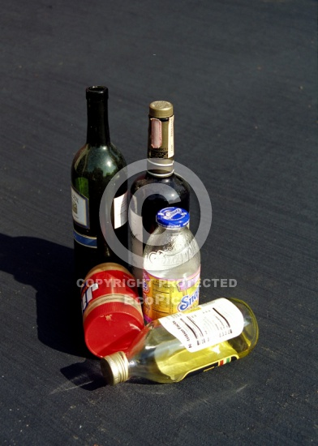
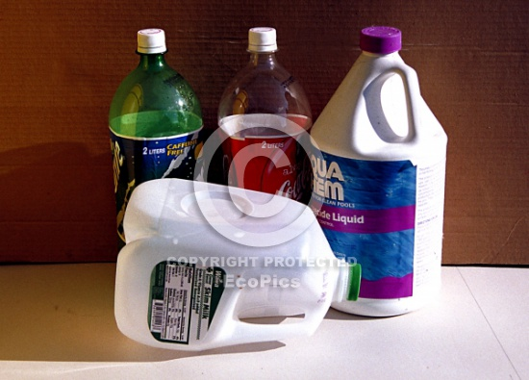
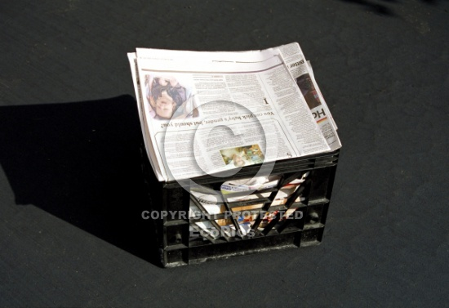
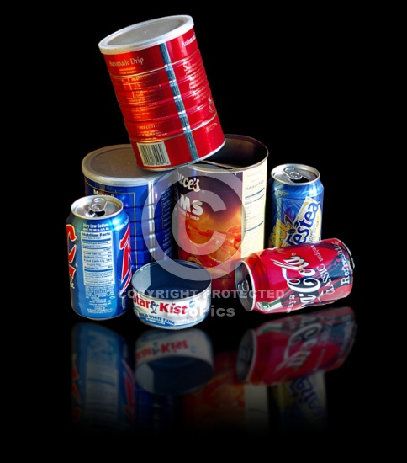
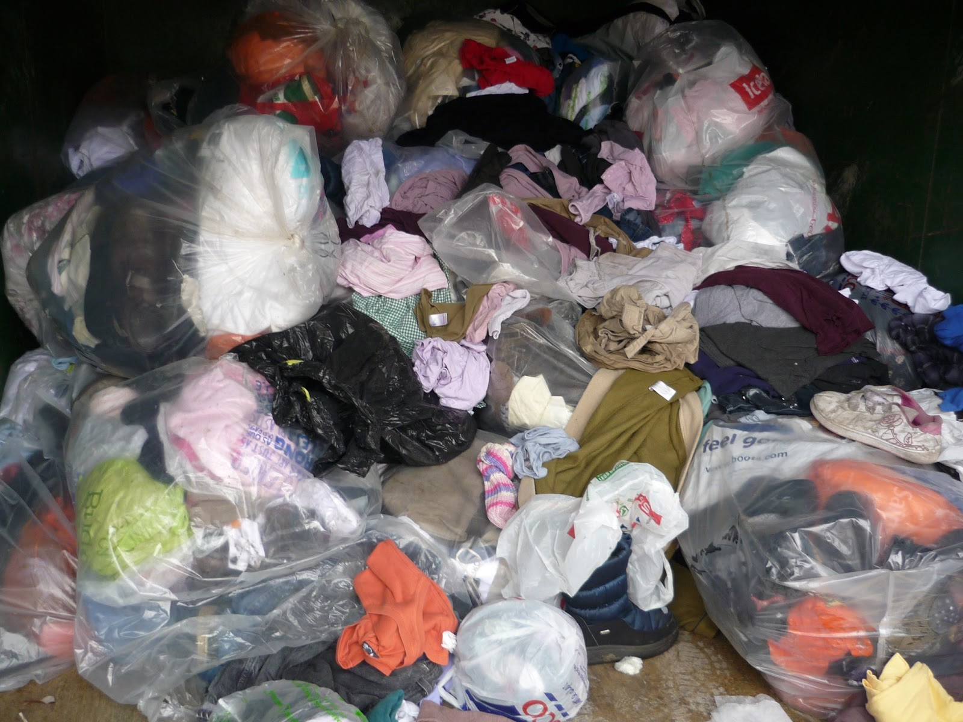
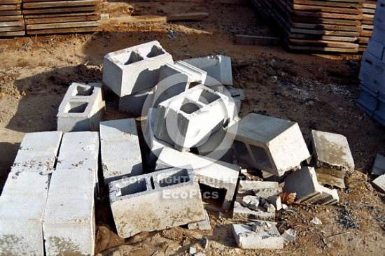
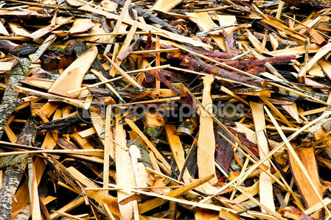
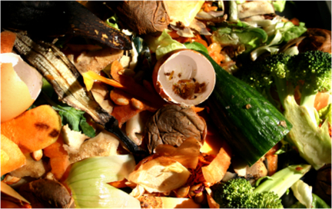
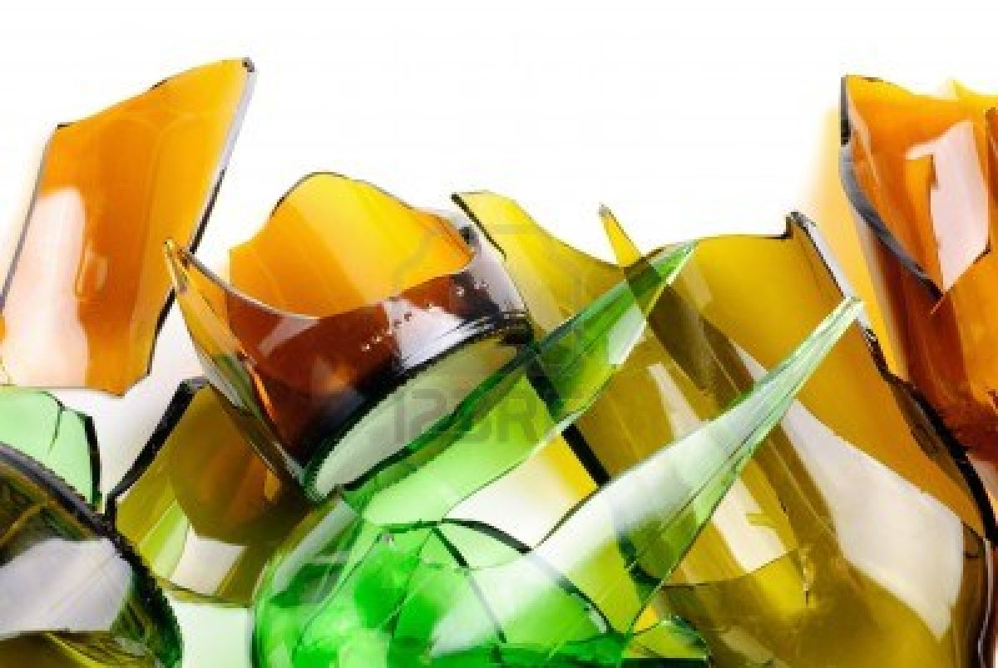
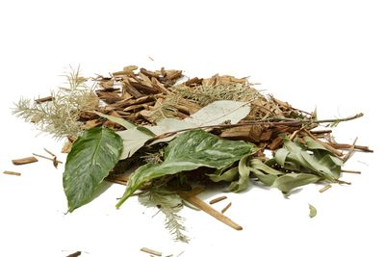
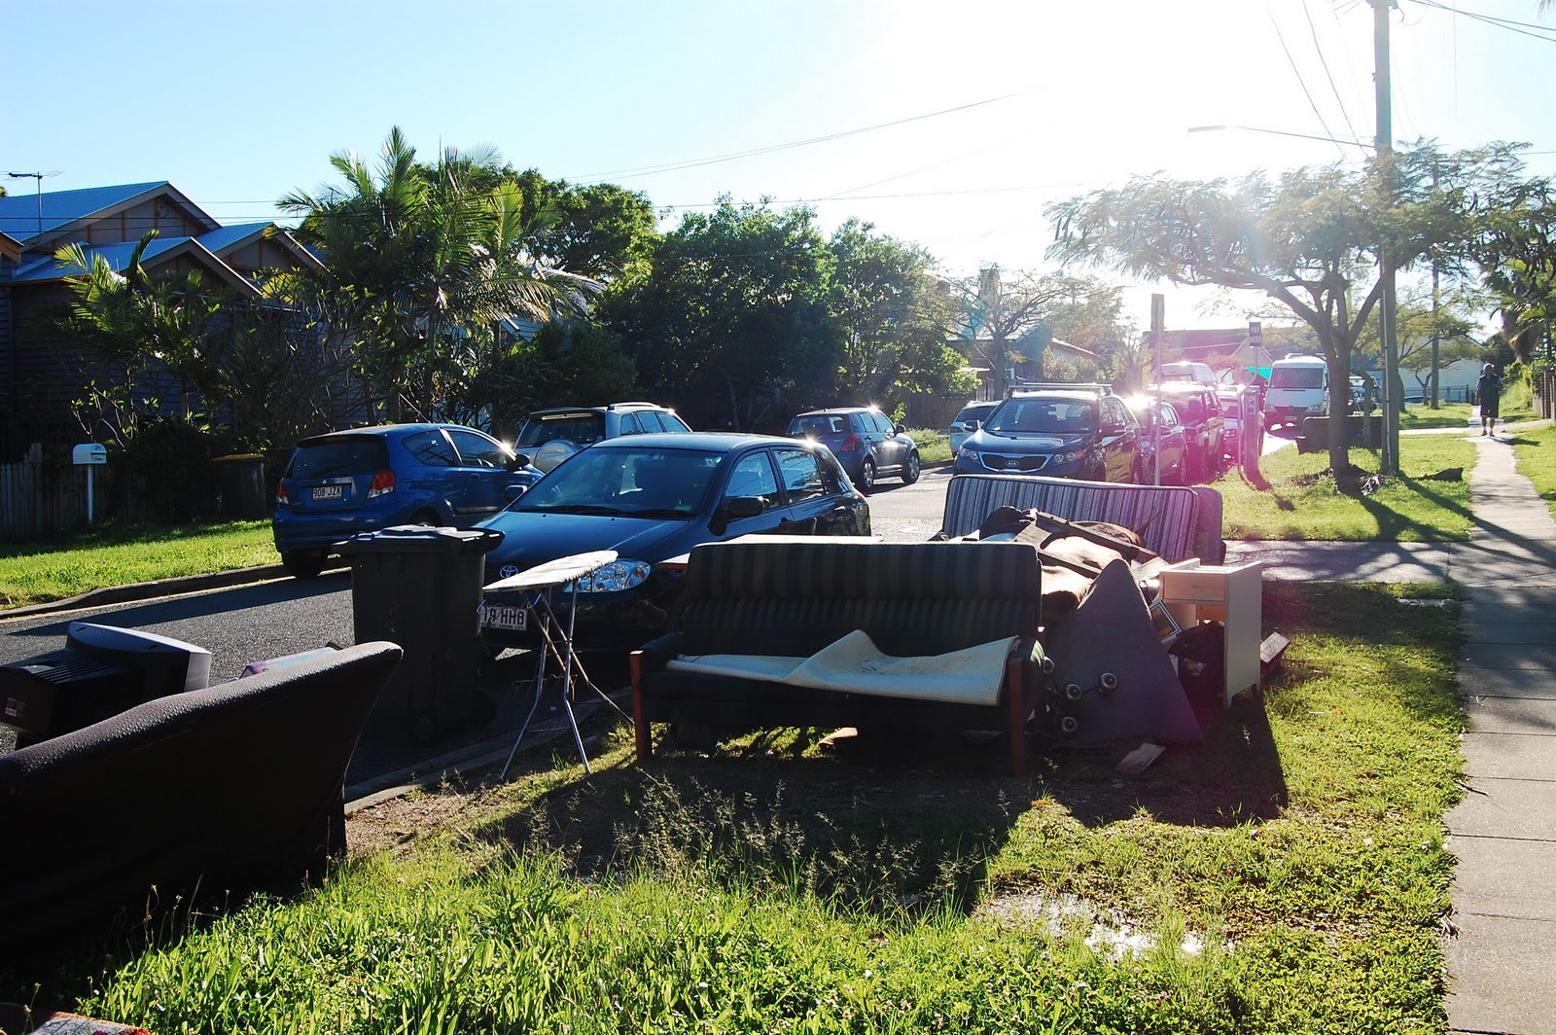
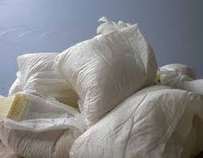
Our Domestic Waste
Glass
Plastics
Cardboard
& Paper
Metals
Mixed Packaging
Aggregates
Timber
Organics
Glass
Green
Waste
Other Kerbside
Nappies

Slide 8
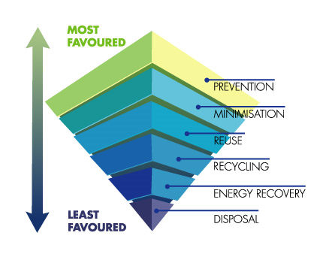
The Whole Deal!
HIGHEST RESOURCE VALUE
LOWEST RESOURCE VALUE

